Slide 1
Targeted Projection Pursuit
Click here for an introduction

Slide 2
Targeted Projection Pursuit (TPP) allows you to visualise high-dimensional data. It shows the full picture behind classification errors, unsupervised clusterings, and attribute selections.
It works by letting you explore projections of your data onto two dimensions

Slide 3
For example, this shows a projection of a three-dimensional data set onto the two-dimensional screen

Slide 4
If we look at the data from a different angle then we can see different aspects, such as how the data can be separated

Slide 5
And the same principal applies to higher dimensional data

Slide 6
And the same principal applies to higher dimensional data

Slide 7
And the same principal applies to higher dimensional data
The problem is then how to ‘steer’ your way through higher dimensional space to find useful views. This is the problem that TPP solves...

Slide 8
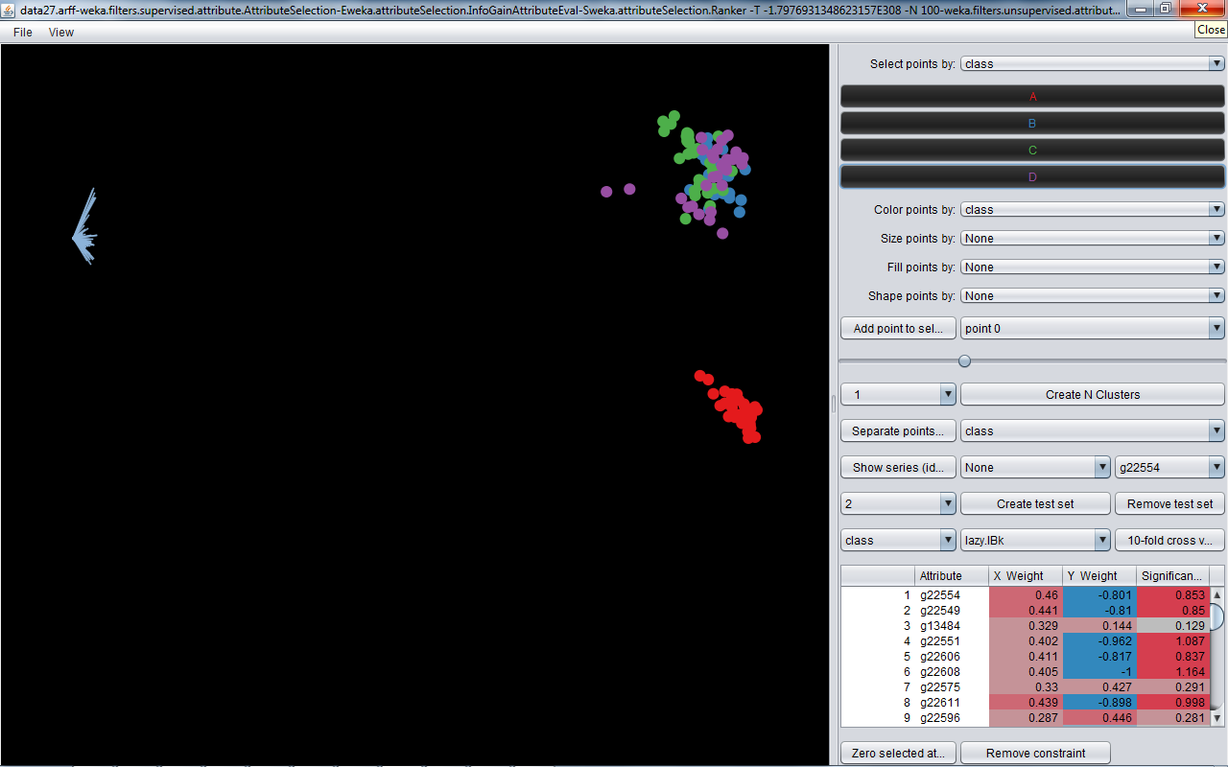
Load up some data and it is initially shown using the first two principal components (X=PC1, Y=PC2).

Slide 9
In this case there are 123 points, each representing a sample taken from a cancer tumor. For each sample we have measured the expression level of 100 genes. Each sample is classified into one of four types – indicated by color.

Slide 10
This shows the axes
And this shows the components (X and Y). The table also shows the overall length of each axis (Significance). Click on the column header to re-order the table.

Slide 11

Select points by clicking on the class button or by dragging a rectangle round them

Slide 12
The color of the axes then shows their relative values for the selected points (blue=low, red=high)

Slide 13
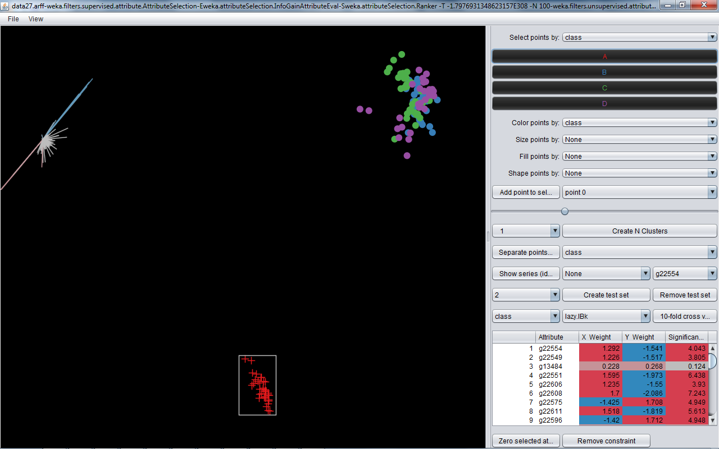
TPP lets you find other views of the data by dragging selected points

Slide 14
The axes move and the table updates as TPP finds a projection that matches your movements

Slide 15
In this case the ‘A’ points can be separated from the others – showing there is a consistent difference in the data

Slide 16
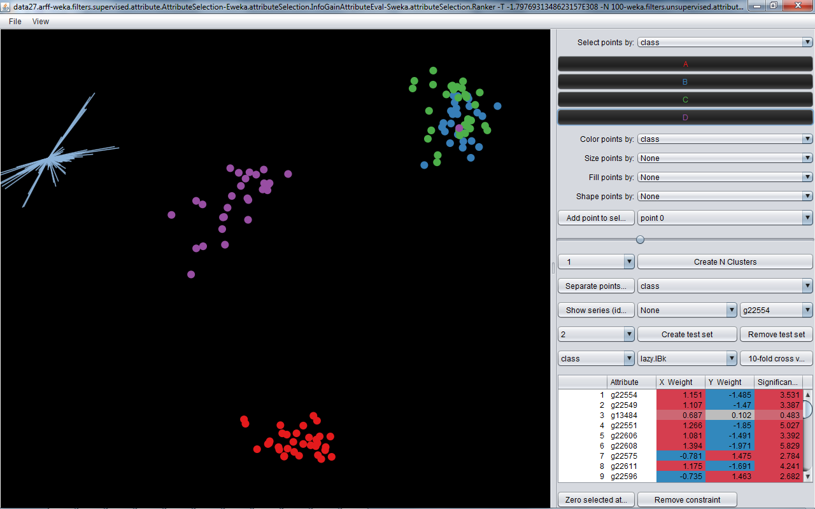
We can also separate the ‘D’ points

Slide 17
But this one didn’t move. This shows it couldn’t be separated from the Bs and Cs. We’ve spotted an outlier, or a possible misdiagnosis.

Slide 18
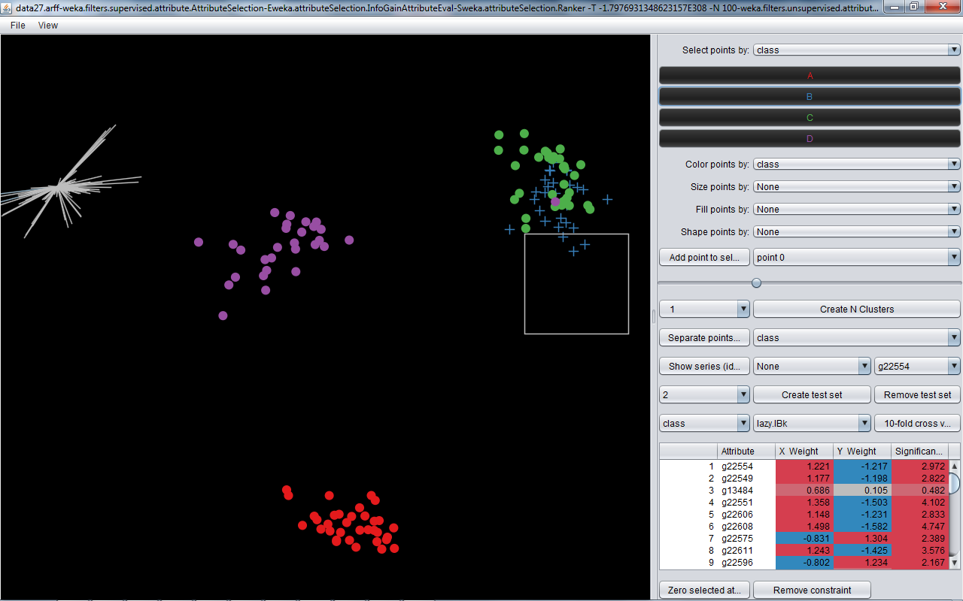
What about the B’s and C’s? Turns out they can’t be separated – showing us the labelled differences don’t correspond to differences in the data

Slide 19
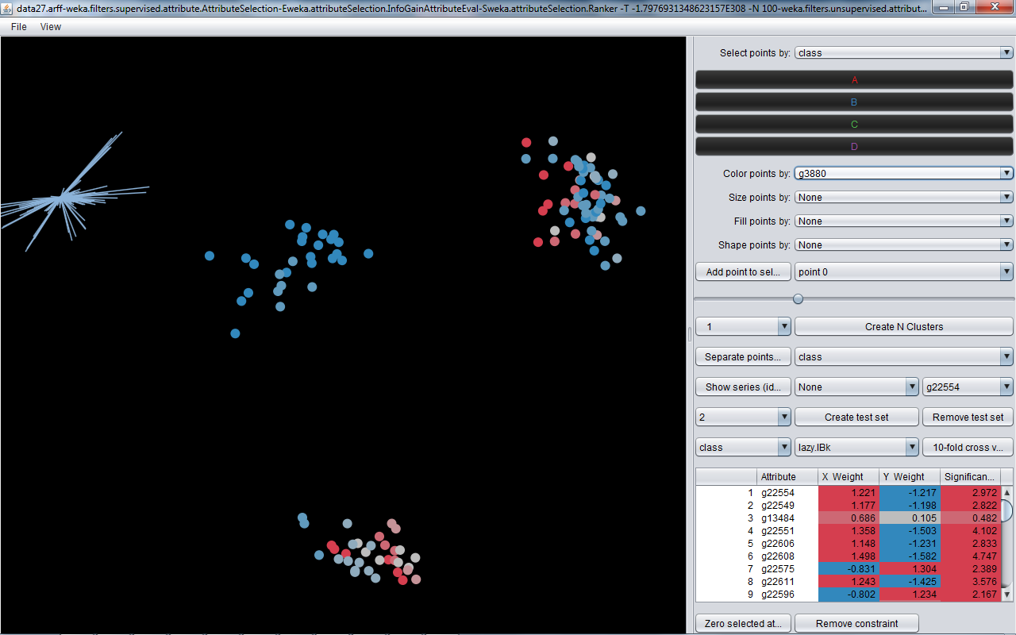
Now we’ve got a clear view of the classes we can the color points by the values of individual attributes

Slide 20
In this case we can see that this gene is low for all of the C’s, but no there’s no reliable pattern for the other classes

Slide 21
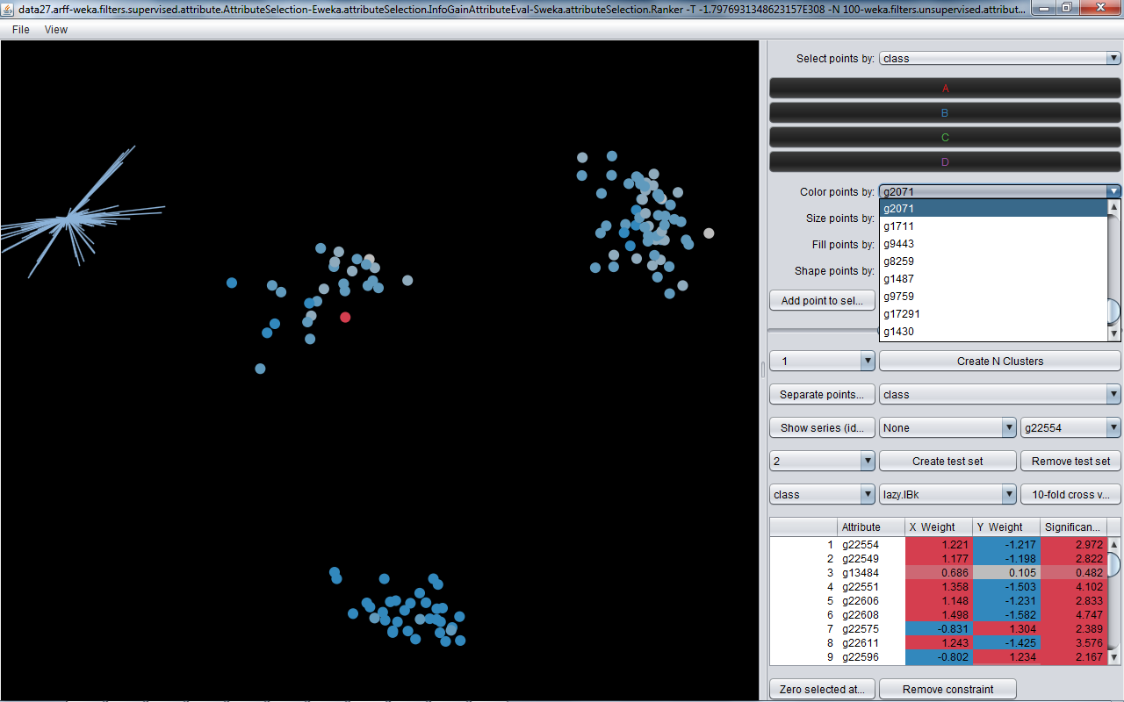
And this gene is exceptionally high for just this one sample. Could be worth investigating.

Slide 22
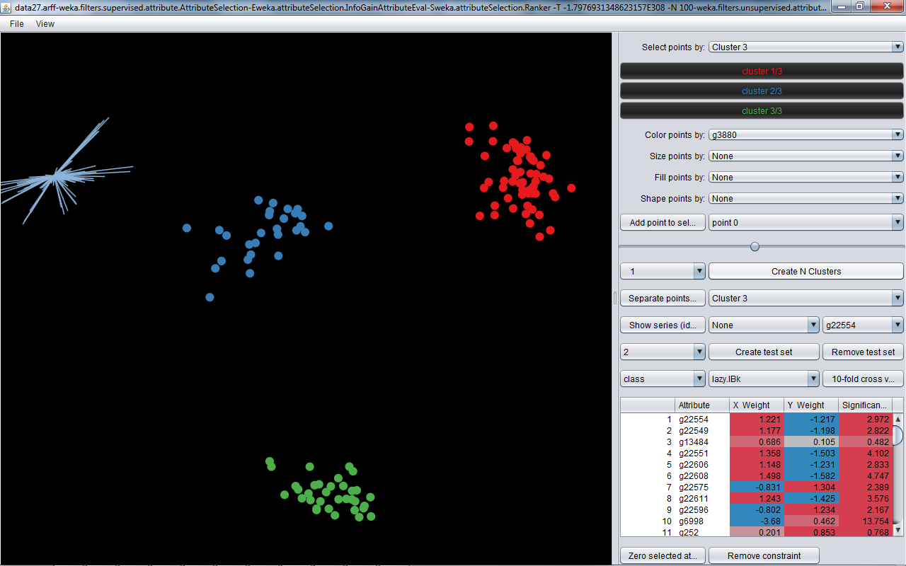
We can also create and look at clusters. Here we create three clusters (shown by color) and see that they correspond to the groupings in the data we found.

Slide 23
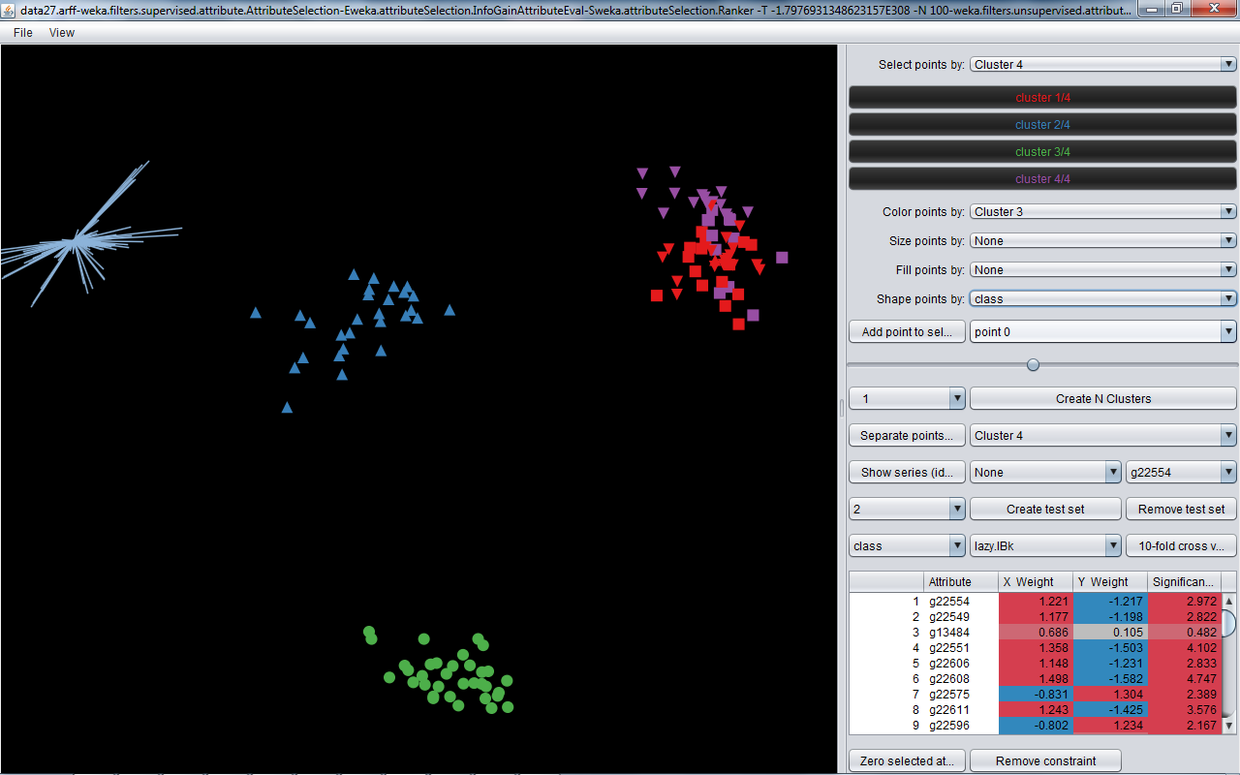
Now try four clusters. The B-C group gets split up, but the split doesn’t correspond to the original classes. (Clusters shown by color; supervised classes shown by shape.)

Slide 24
It looks like the samples ‘naturally’ divide into three rather than four clusters.

Slide 25
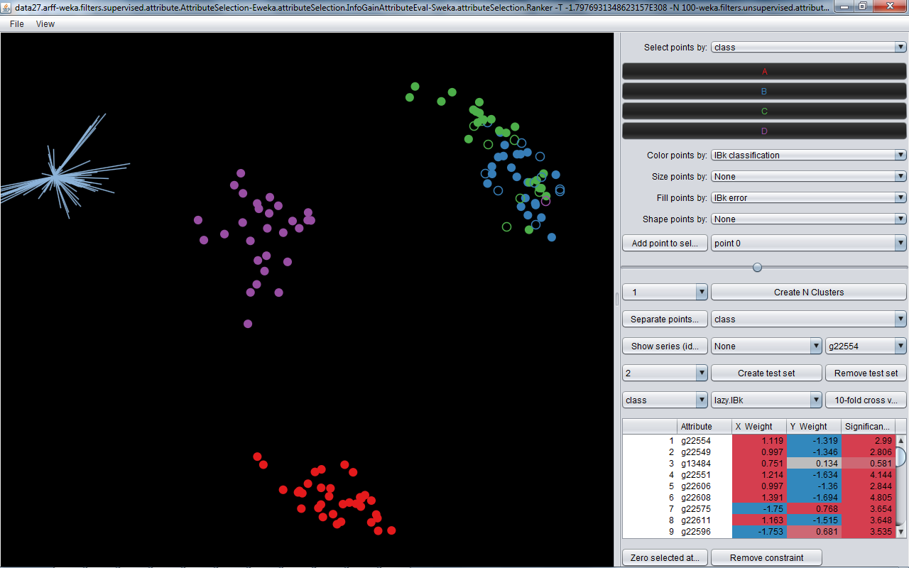
Lets see how a classification algorithm would perform on this data. Here we’ve used a KNN classifier from the Weka toolkit, with 10-fold cross validation. The empty circles show the errors.

Slide 26
All the errors occur in the B-C group as expected – including that possible misdiagnosis we spotted earlier.

Slide 27
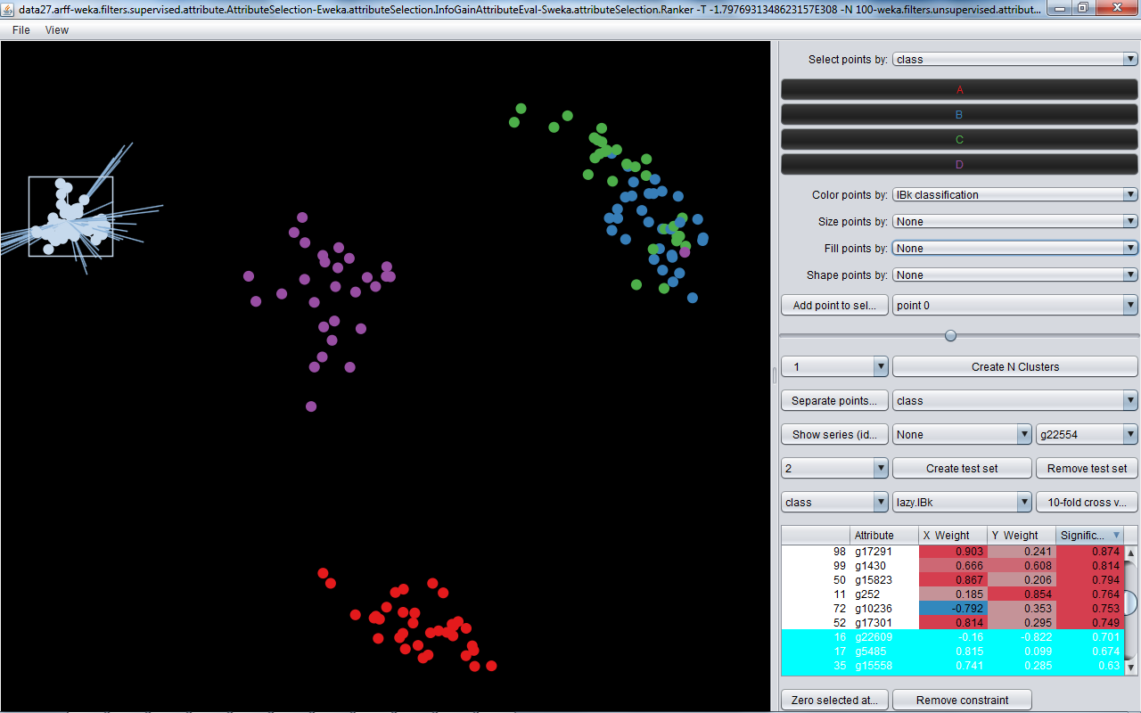
Now lets see which genes are the important ones by selecting attributes. Select all the shortest axes and set them to zero.

Slide 28
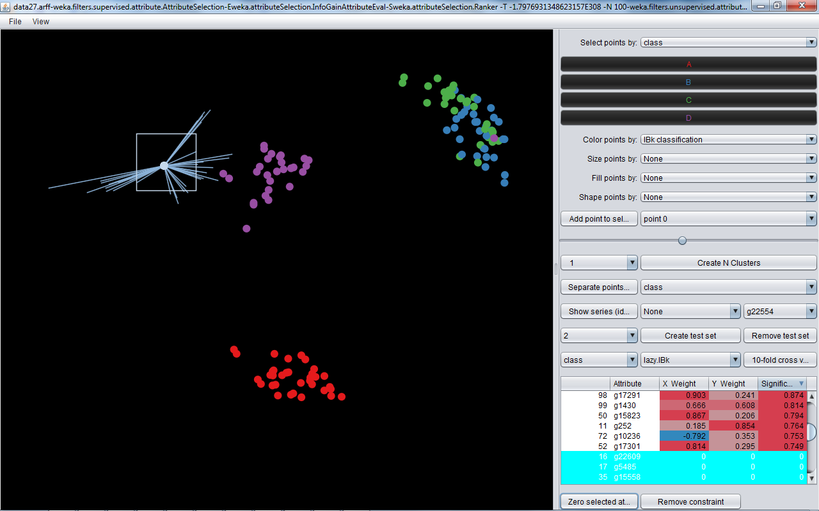
There’s still very good separation – we could eliminate some more

Slide 29
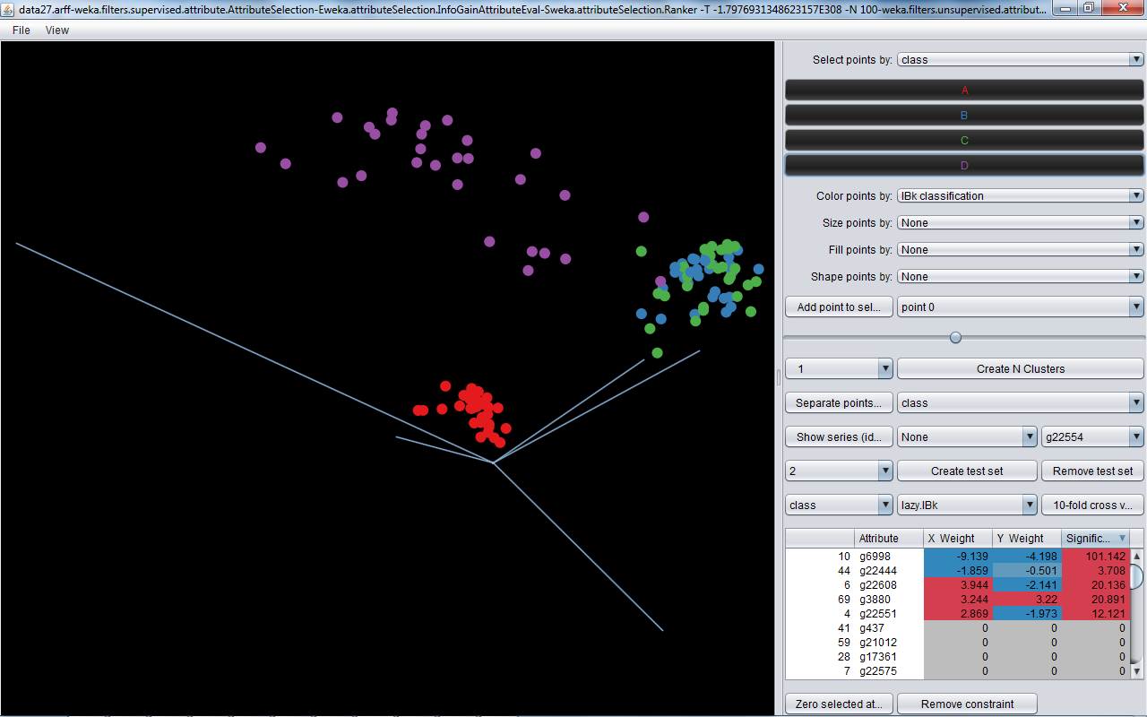
And soon we find just five genes that between them distinguish the types of cancer – and see how they act together

Slide 30
Click on ‘File’ to load a data file

